Slide 1


Slide 2

(WEBSITE LOGO)
ID Number | Student Name
52213116280 | MUHAMAD FAIZ BIN HISHAMMUDDIN
52213116286 | AFIQ IZZUDDIN BIN MOHAMAD BUKHAREE
52213116044 | SYED ZARUL ZAQUAN BIN SYED MUHAMAD ZULKIFLI
52213116292 | WAN MOHAMAD NAIMAN BIN WAN MAYU OTHMAN

Slide 3
Programming Language used
Website – PHP , HTML , CSS
Database - Xampp

Slide 4
Content
Register ,Edit & Delete Admin & Consumer
Add, Edit & Delete Sneaker
Add, Edit & Delete Category
Add, Edit & Delete Order
Login

Slide 5
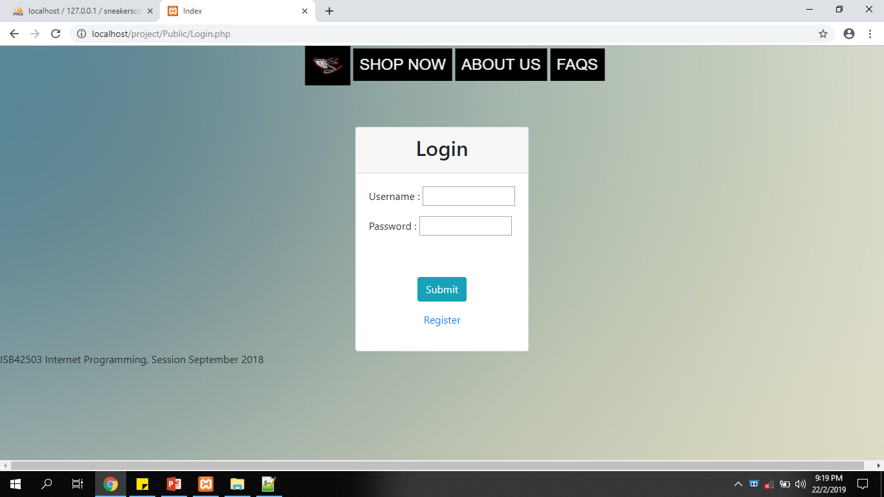
Login Form (Admin & Member)

Slide 6
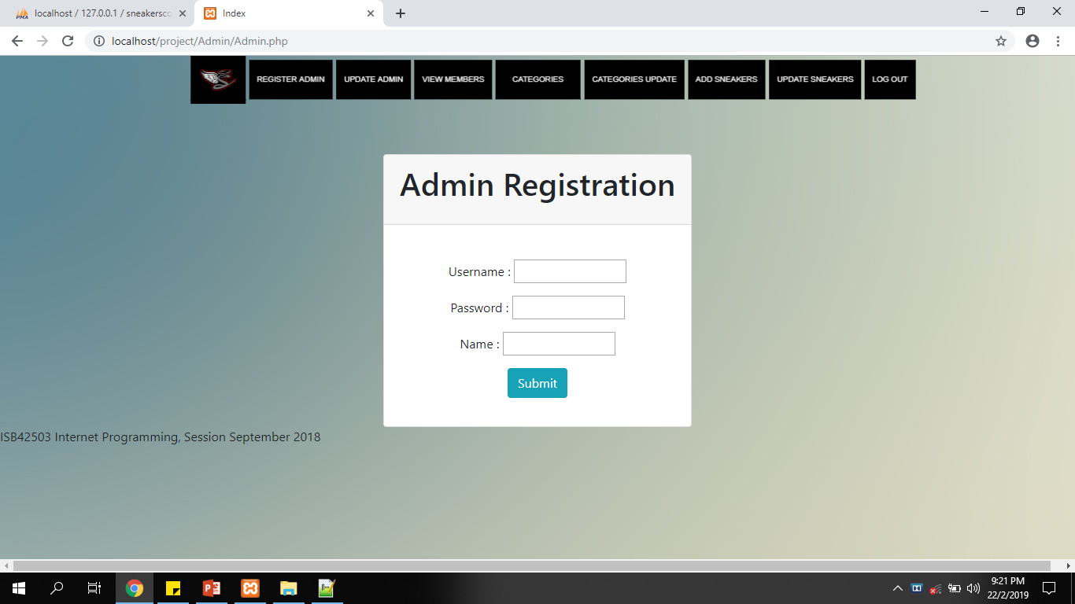
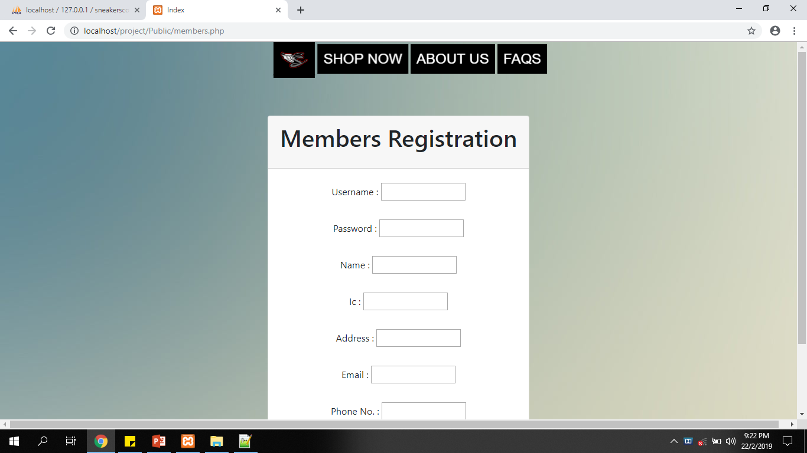
Register Admin & Member

Slide 7
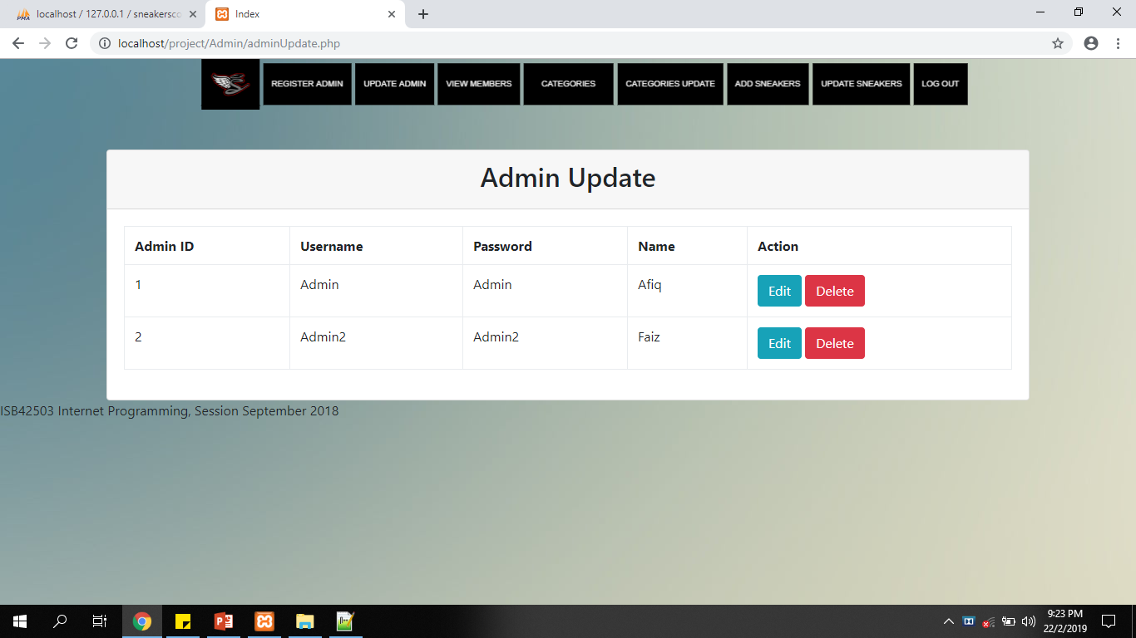
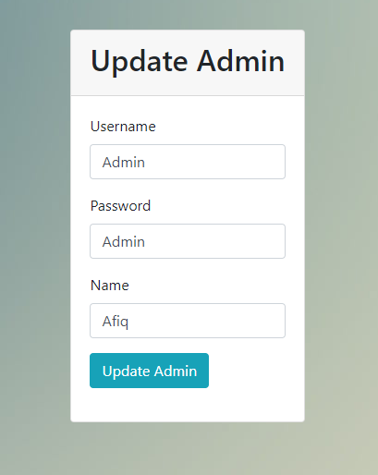
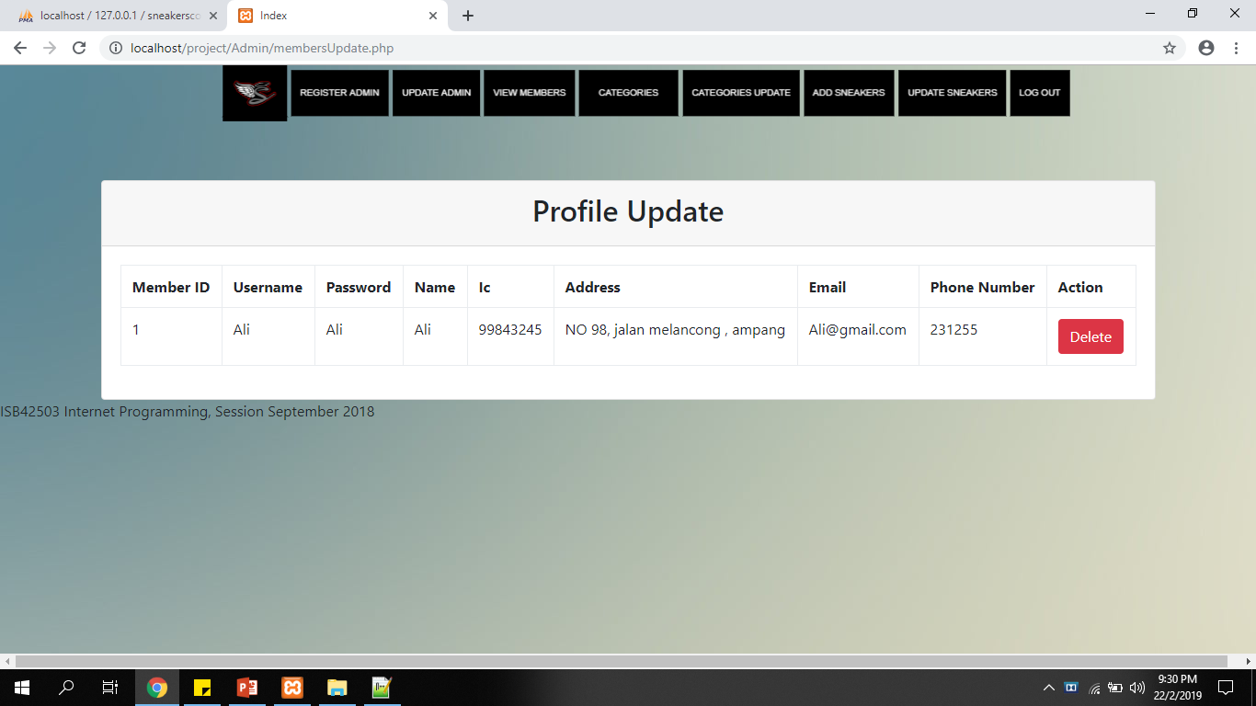
Edit & Delete Admin Delete Member

Slide 8
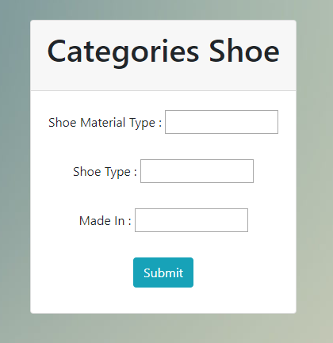
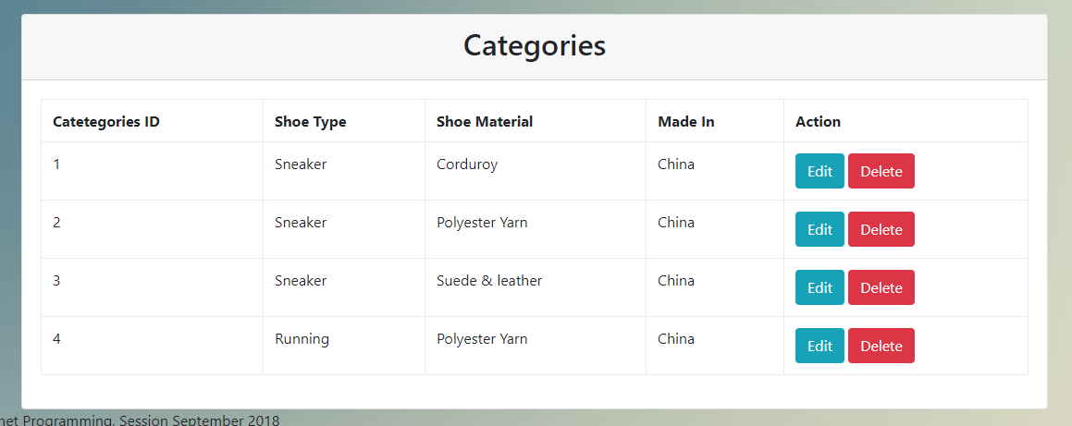
Add, Edit & Delete Categories

Slide 9
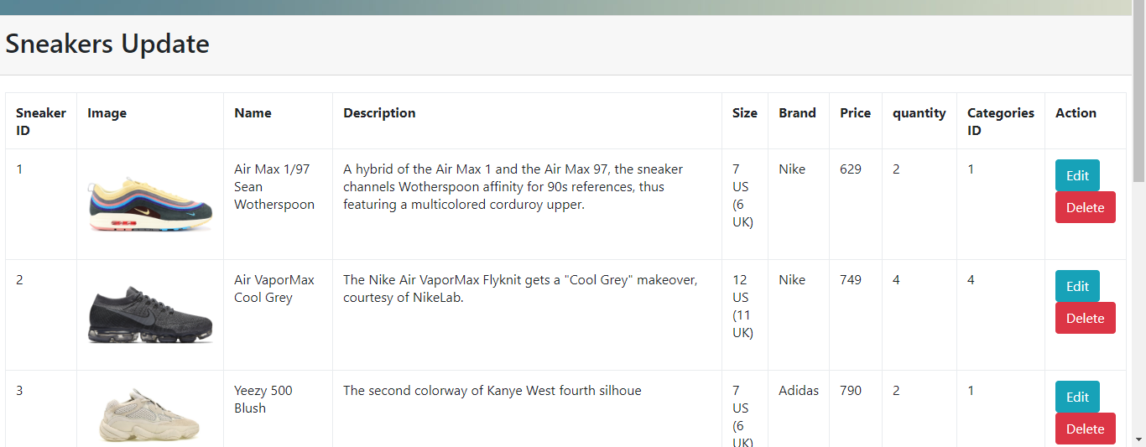
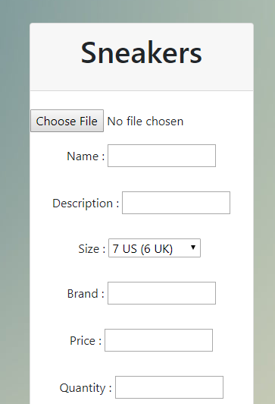
Add , Edit & Delete Sneakers

Slide 10
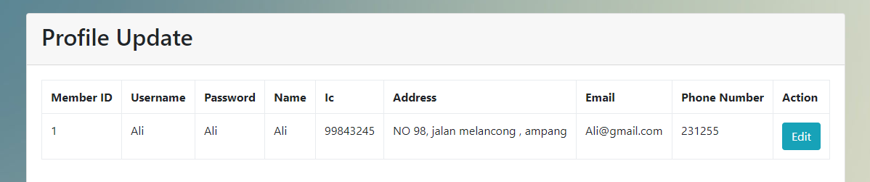
Edit Member information

Slide 11
Improvement
Add QR code
Improve design and support mobile view

